Slide 1
Title: Beyond the Smile: Unveiling the Impact of Dental Disease on Skin Health
Presenter Name Dr.Shohreh Ghasemi
Affiliation / Institute: MD,DDS,MSC,PH.D
Queen Mary University of London ,UK
Dental Faculty (RCSI ,Ireland )
Email:shohrehghasemi24@gmail.com

Slide 2
Abstract
**Introduction**
- **Objective of the Presentation:**
To explore the connection between dental disease and skin health, highlighting the impact of oral health on overall well-being.
- **Importance of Oral Health:**
- Oral health is crucial not just for a beautiful smile but also for maintaining overall health.
- Understanding how dental issues can influence skin conditions emphasizes the need for comprehensive healthcare.
-** Conclusion
. By unveiling the impact of dental disease on skin health, this paper advocates for a more holistic approach to healthcare that recognizes the interconnectedness of oral and dermatological health, ultimately aiming to improve patient outcomes through interdisciplinary collaboration and education.
---

Slide 3
"The Link Between Oral Health and Skin Conditions"
**Chronic Inflammation:
Dental diseases such as periodontal disease can lead to systemic inflammation.
Inflammation can trigger or exacerbate skin conditions like acne, psoriasis, and eczema.
**Bacterial Pathways:
Oral bacteria can enter the bloodstream through inflamed gums.
These bacteria may contribute to skin infections and flare-ups.
**Common Skin Conditions Affected:
Acne: Increased inflammation may worsen acne.
Eczema: Oral health issues can trigger eczema flare-ups in susceptible individuals.
Rosacea: Gum disease may be linked to the severity of rosacea symptoms.

Slide 5
Inflammation and skin condition
Role of Inflammation:
- Chronic inflammation from dental diseases can have widespread effects on the body, including the skin.
- Inflammatory responses can disrupt normal skin function and exacerbate existing conditions.
Connection to Specific Skin Conditions:
Acne:
- Inflammation contributes to the formation of acne lesions.
- Increased sebum production and clogged pores are worsened by inflammatory processes.
-Eczema:
- Oral infections can trigger immune responses that may lead to eczema flare-ups.
- Individuals with eczema may experience worsened symptoms due to poor oral health.
Psoriasis:
- Chronic inflammation linked to periodontal disease can increase the severity of psoriasis.
- The interplay between skin and oral health may indicate a need for integrated treatment approaches.
Management Strategies
- Maintaining Oral Hygiene
-Regular brushing and flossing can reduce inflammation and improve skin health.
-Diet and Lifestyle
- Anti-inflammatory diets may help manage both oral and skin health.
- Stress management techniques can also reduce inflammation.
1. **Kumar, R., & Gupta, A. (2016).** "Periodontal Disease and Its Impact on Skin Health: A Review." *International Journal of Medical Sciences*, 13(3), 202-209. . DOI: 10.7150/ijms.14051
2. **Tzeng, Y. H., & Huang, J. Y. (2018).** "The relationship between periodontal disease and skin diseases: A review." *Journal of the Formosan Medical Association*, 117(9), 733-739.
DOI: 10.1016/j.jfma.2018.01.012

Slide 6
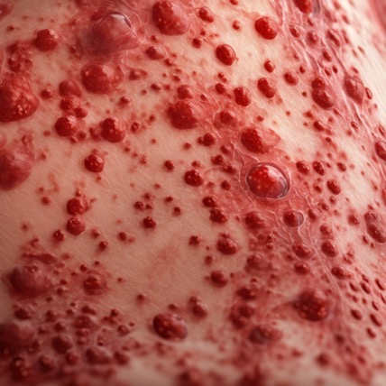

Slide 7
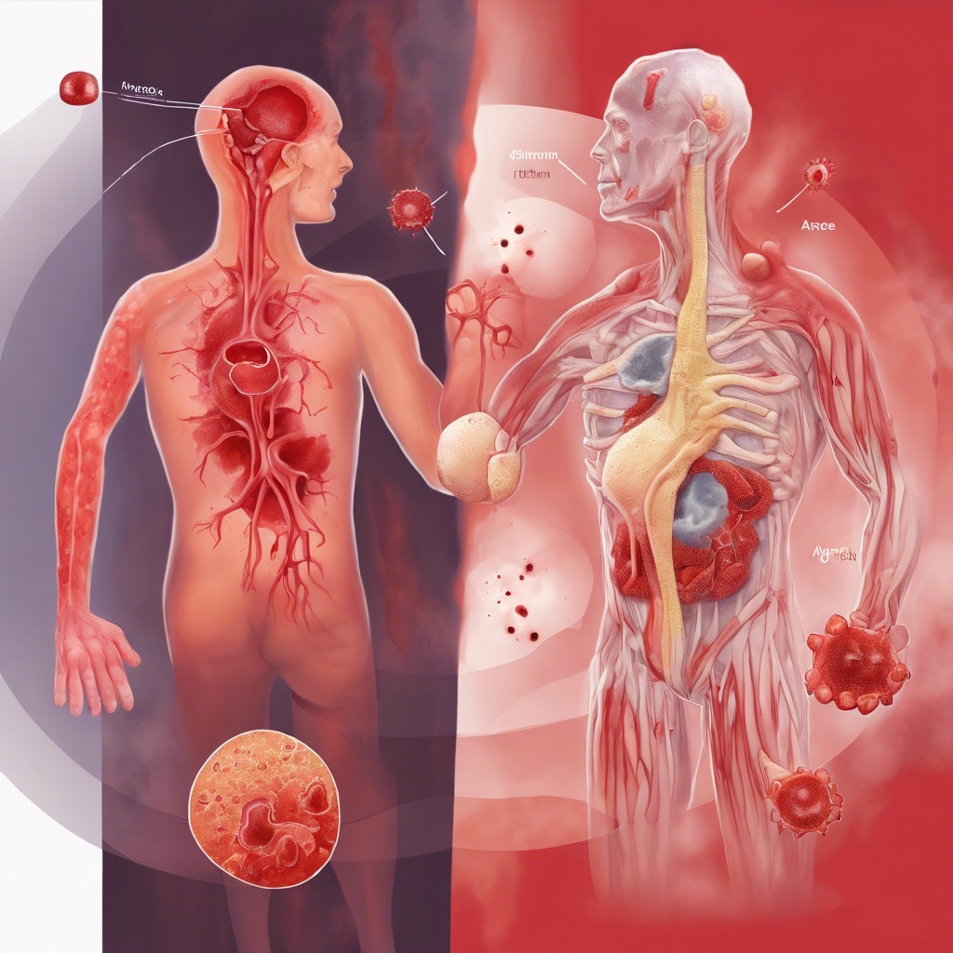

Slide 8
Significant effects on both oral and skin health, acting as a common underlying factor in various conditions:
1. **Periodontal Disease:**
- Inflammation is a hallmark of periodontal disease, where the body’s immune response to bacteria in the mouth leads to gum inflammation, tissue destruction, and bone loss.
- Symptoms include swollen, bleeding gums, bad breath, and tooth mobility.
2. **Increased Risk of Infections:**
- Chronic inflammation can weaken the immune system, making the oral cavity more susceptible to infections, such as oral thrush or abscesses.
3. **Oral Lesions:**
- Conditions like lichen planus or aphthous ulcers are often linked to inflammatory processes and can cause painful lesions in the mouth.
4. **Systemic Implications:**
- Poor oral health due to inflammation can contribute to systemic diseases, including cardiovascular disease and diabetes, which can, in turn, increase inflammation further.

Slide 10
Effects of Inflammation on Skin Health:
1. Skin Conditions: - Inflammation is a key factor in various skin conditions, such as acne, eczema, psoriasis, and rosacea. In these conditions, the inflammatory response can cause redness, swelling, and irritation.
2. Barrier Function: - Chronic inflammation can compromise the skin's barrier function, leading to increased water loss and susceptibility to irritants and pathogens.
3. Increased Oil Production: - Inflammatory mediators can stimulate sebaceous glands to produce more oil, contributing to clogged pores and worsening acne.
4. Healing and Repair: - While acute inflammation is necessary for healing, chronic inflammation can hinder the skin's ability to repair itself, leading to persistent skin issues.

Slide 12
The Connection Between Oral and Skin Health:
Systemic Inflammation:
- Inflammation in the oral cavity can contribute to systemic inflammation, which affects various body systems, including the skin.
Bacterial Translocation:
- Oral bacteria can enter the bloodstream through inflamed gums, potentially leading to skin infections or exacerbating existing skin conditions.
Shared Risk Factors:
- Poor diet, smoking, and stress can contribute to inflammation in both the oral cavity and skin.

Slide 13
Focusing on Bacterial Influence on Skin Conditions:
1. Normal Skin Microbiome - The skin hosts a diverse range of bacteria that play a crucial role in maintaining skin health.
- A balanced microbiome helps protect against pathogens, regulates inflammation, and supports the skin barrier.
2. Dysbiosis: - Dysbiosis refers to an imbalance in the skin microbiome, which can lead to various skin conditions.
- Factors contributing to dysbiosis include poor hygiene, use of antibiotics, diet, and environmental influences.
3. Acne: - Propionibacterium acnes (P. acnes):
- This bacterium is commonly associated with acne development.
- Inflammation occurs when P. acnes proliferates in clogged pores, leading to inflammatory lesions.
4. Eczema - Staphylococcus aureus

Slide 14
5. Psoriasis
- Dysbiosis in the skin microbiome may contribute to the severity of psoriasis.
- Certain bacteria may trigger inflammatory responses, worsening the condition.
6. Rosacea:
- Rosacea may be influenced by skin bacteria, particularly *Demodex* mites that harbor bacteria. - These microorganisms can provoke inflammatory responses, leading to rosacea flare-ups.

Slide 15
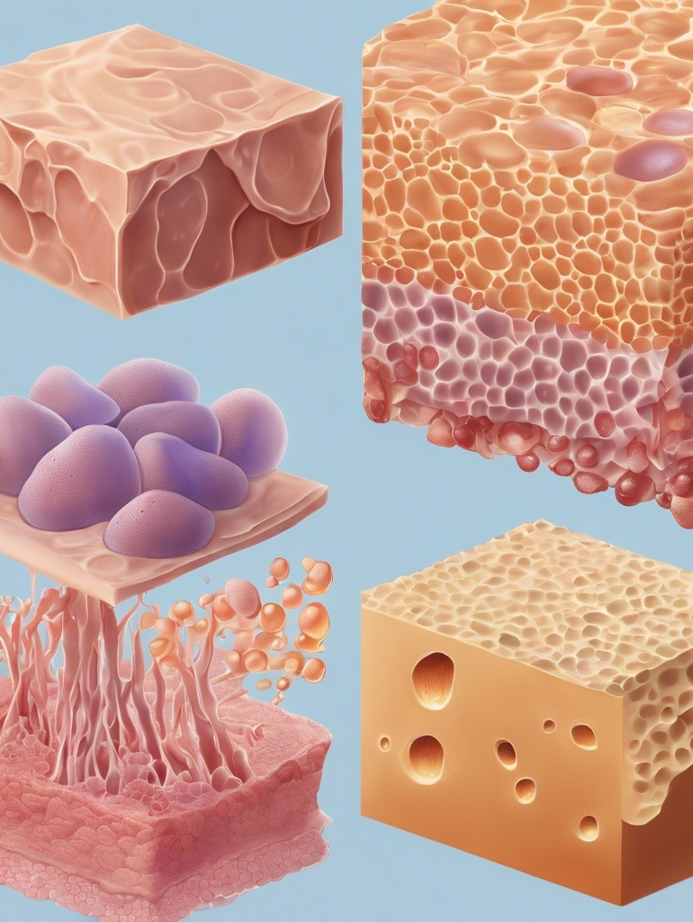
1. Protection
- **Physical Barrier**: The skin barrier acts as a protective shield against external threats, including bacteria, viruses, and environmental pollutants. It helps prevent infections and skin diseases.
- **Chemical Defense**: It protects against harmful chemicals and irritants that can penetrate the skin and cause damage.
2. Water Retention
- **Moisture Regulation**: The skin barrier helps to retain moisture within the skin, preventing transepidermal water loss (TEWL). This is crucial for maintaining skin hydration and preventing dryness.
3. Thermoregulation
- **Temperature Control**: The skin barrier plays a role in regulating body temperature by controlling moisture loss and preventing overheating. It helps maintain a stable internal environment.
4. Sensory Perception
- **Nerve Endings**: The skin barrier contains nerve endings that allow the skin to sense touch, temperature, pressure, and pain. This sensory function is vital for interacting with the environment and protecting against injury.
5. Immune Function
- **Immune Response**: The skin barrier is involved in the immune response by acting as the first line of defense. It contains immune cells that help detect and respond to pathogens, reducing the risk of infections.
6. Aesthetic and Cosmetic Role
- **Appearance**: A healthy skin barrier contributes to the overall appearance of the skin, giving it a smooth, hydrated, and radiant look.

Slide 16
**Future Directions in Treatment:**
- Probiotics and prebiotics are being explored for their potential to restore balance in the skin microbiome.
- Personalized skincare products targeting specific bacterial profiles may improve outcomes in various skin conditions.

Slide 17
The future direction for preventing skin diseases related to oral health focuses on an integrated and holistic approach. Key trends include:
1. **Integrated Healthcare Approaches**: Collaboration among dentists, dermatologists, and nutritionists to create comprehensive treatment plans.
2. **Research on Oral Microbiome**: Exploring the links between oral bacteria and skin conditions, potentially leading to probiotic-based interventions.
3. **Education and Awareness Campaigns**: Public health initiatives to promote the connection between oral hygiene and skin health, enhancing patient education.
4. **Innovative Oral Care Products**: Development of antimicrobial and skin-beneficial oral care products to reduce harmful bacteria.
5. **Nutrition and Dietary Interventions**: Research on diets that support both oral and skin health, including potential supplementation.
6. **Preventive Care Strategies**: Routine screenings for oral health during dermatological visits and personalized preventive care plans.
7. **Technological Advancements**: Utilization of telehealth and wearable technology for monitoring and proactive management of oral and skin health.

Slide 20
REFRENCES
1. American Academy of Dermatology. (n.d.). *The oral-systemic health connection*. Retrieved from [https://www.aad.org](https://www.aad.org)
2. Proksch, E., Jensen, W., & Tschachler, E. (2018). Microbiome and skin health: A review. *Frontiers in Microbiology, 9*, 1-13. https://doi.org/10.3389/fmicb.2018.00524
3. Pires, A. M., & Mendes, J. J. (2020). The role of oral health in dermatologic diseases. *Dermatologic Clinics, 38*(3), 337-351. https://doi.org/10.1016/j.det.2020.02.002
4. Kassebaum, N. J., & Smith, A. G. (Eds.). (2018). *Oral health and systemic disease*. Springer. https://doi.org/10.1007/978-3-319-79592-8
### Guidelines and Reports
5. American Academy of Dermatology. (2020). *Guidelines for the management of skin diseases related to oral health*. Retrieved from [https://www.aad.org](https://www.aad.org)
6. Centers for Disease Control and Prevention. (2021). *Oral health program*. Retrieved from [https://www.cdc.gov/oralhealth](https://www.cdc.gov/oralhealth)
Online Resources
7. World Health Organization. (2020). *Oral health*. Retrieved from [https://www.who.int/news-room/fact-sheets/detail/oral-health](https://www.who.int/news-room/fact-sheets/detail/oral-health)
8. National Institutes of Health. (2020). *Oral health research*. Retrieved from [https://www.nih.gov](https://www.nih.gov)

Slide 21
Thank you for all your time and attention

